Slide 1
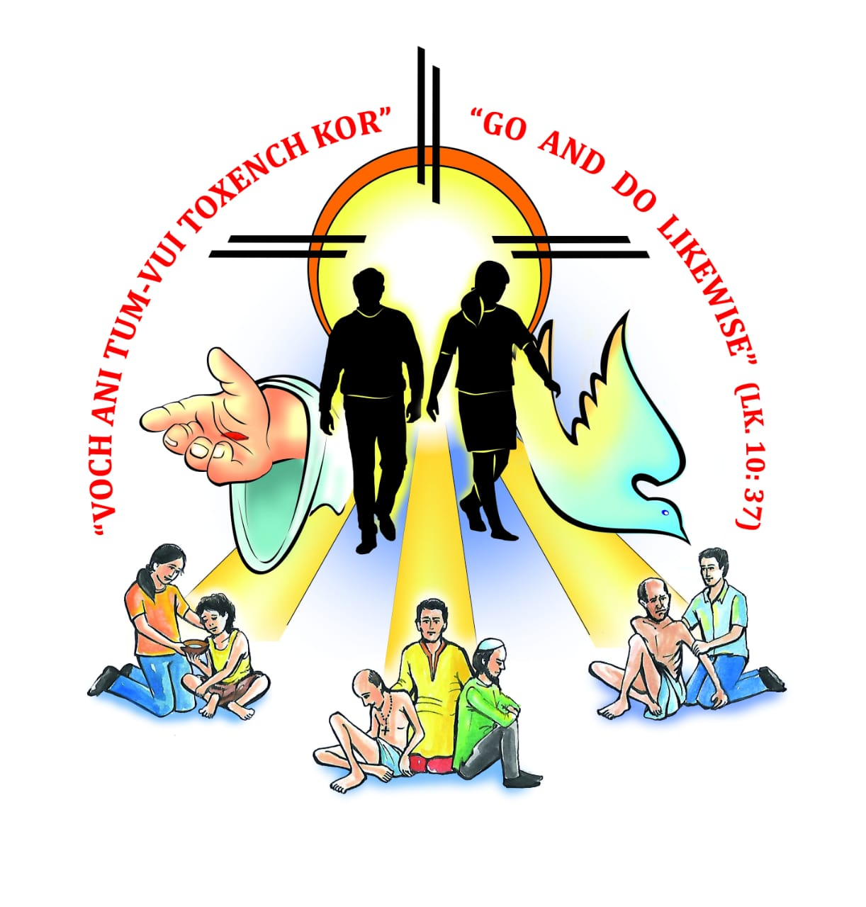
PASTORAL LETTER 2019 20

Slide 2
reminded ourselves that we are anointed by God to seek solutions and to eradicate the different types of poverty
2017 - 2018
urged us to do good to others...
2018 – 2019

Slide 3
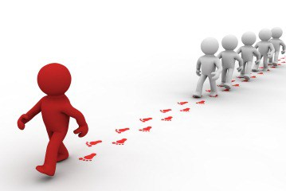
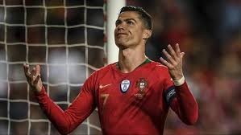
Human beings in our times are seen to take up role models…

Slide 4
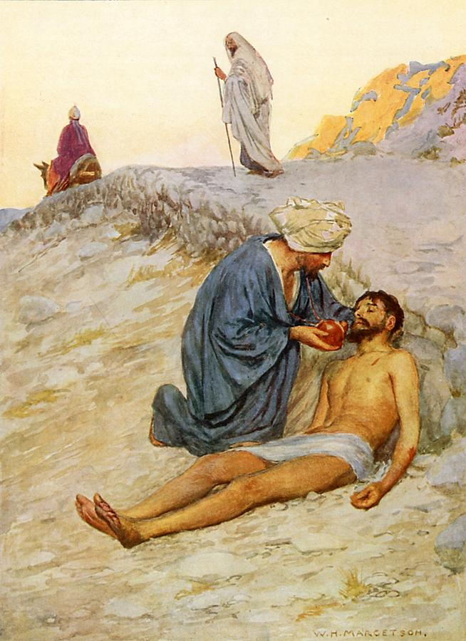
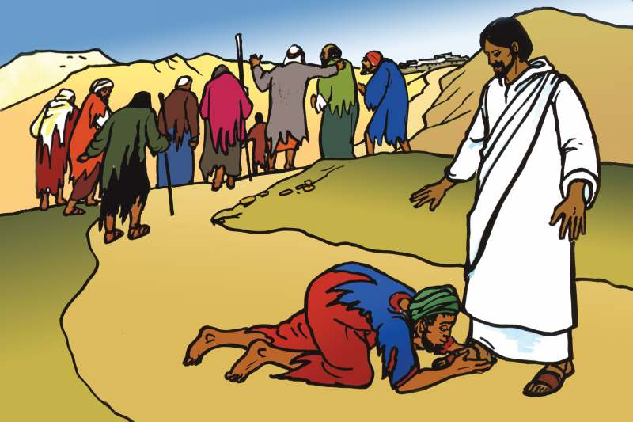
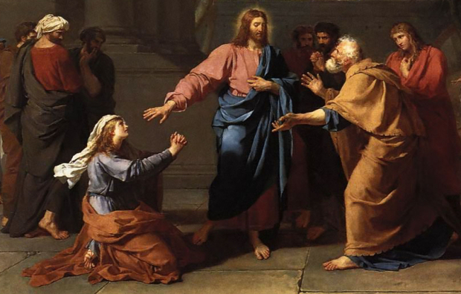
Preaching the Kingdom of God in His public ministry, Jesus gave His disciples many examples…
Tempted - lofty positions in society and respect
Follow the way of humility and simplicity
Be like little children (Mt 18: 2 - 3).
Thank God for favours - Lone Samaritan leper –
healed 10/9 – only one to thank… (Lk 17; 17 - 18)
Feeble faith - Syro-Phoenician woman – great faith (Mt 15: 28)
Scribe test Him – challenging him to go and do likewise (Lk 10: 25-37)

Slide 5
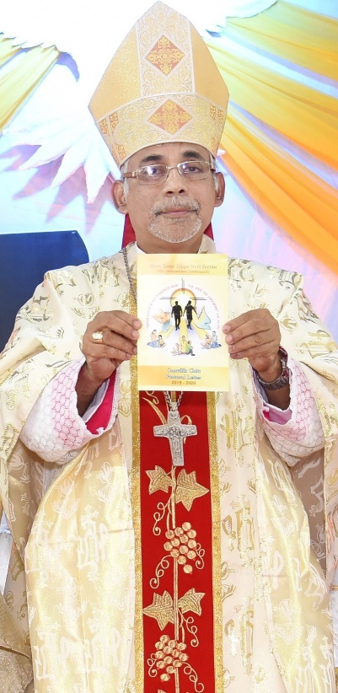
Pastoral Year 2019 -2020
Social responsibility in the light of Faith – Parable of the Good Samaritan

Slide 6
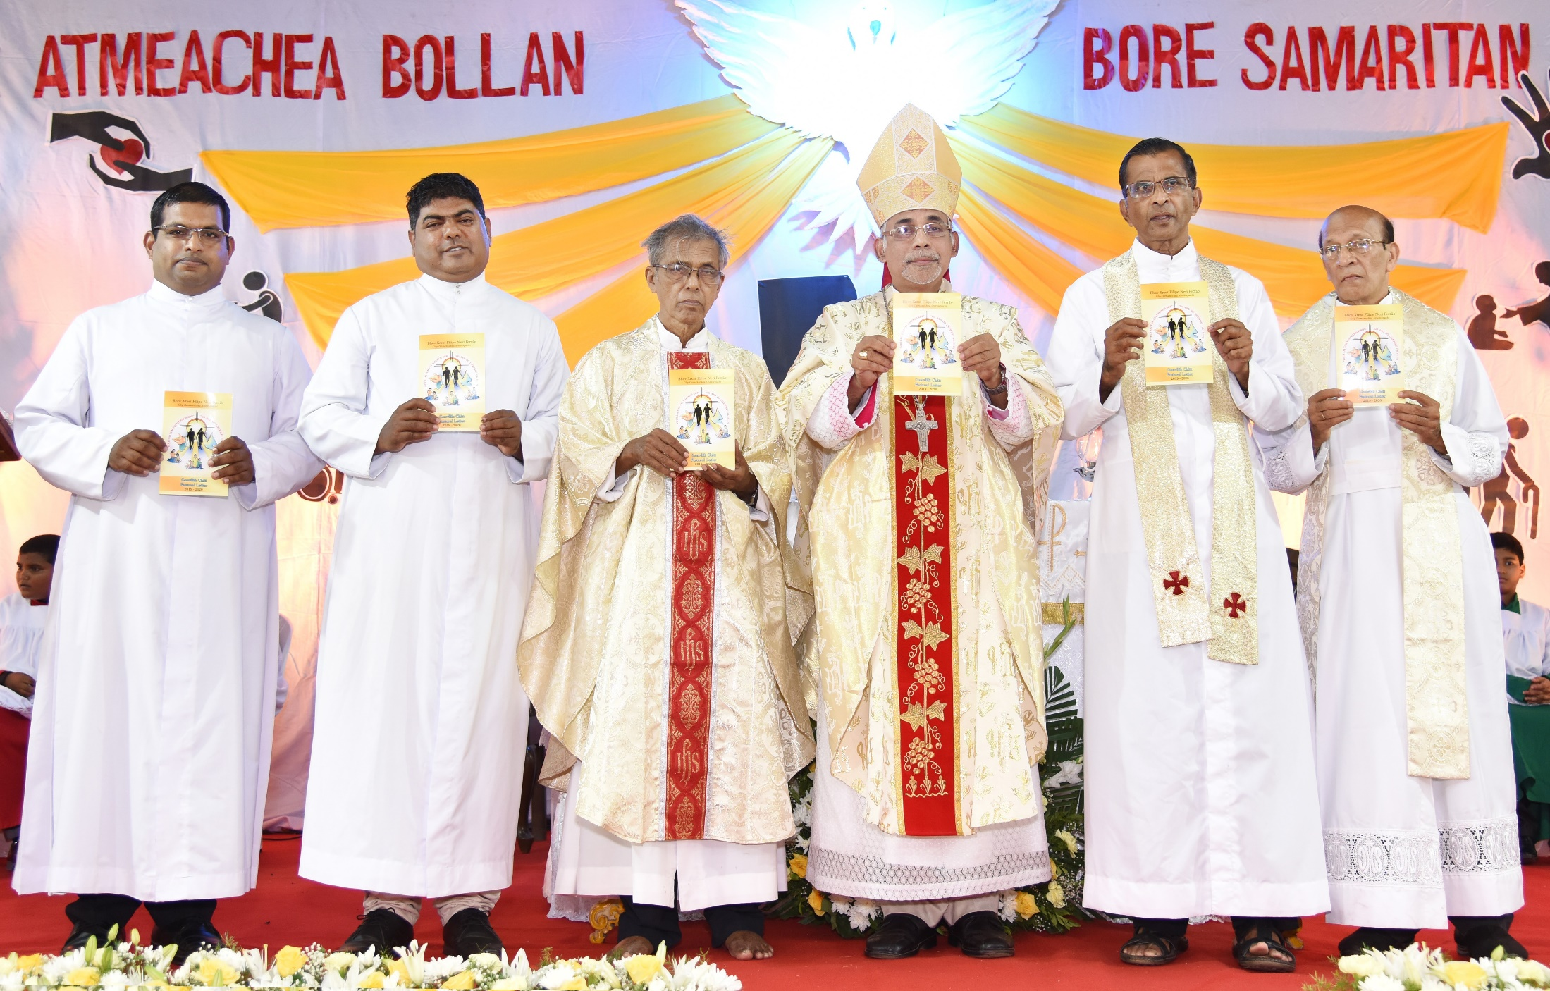
Released at Cristo Rei Hall, Borda, Margao, on 2nd June, 2019, on the occasion of the solemnity of the Ascension of the Lord

Slide 7
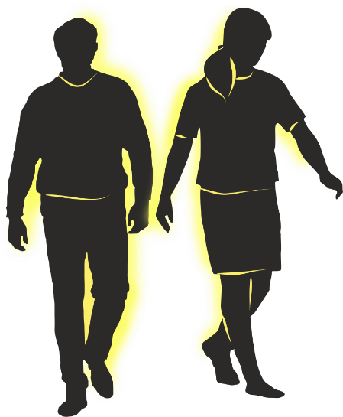
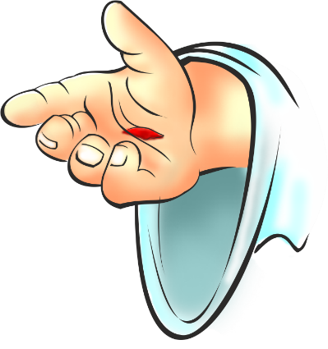
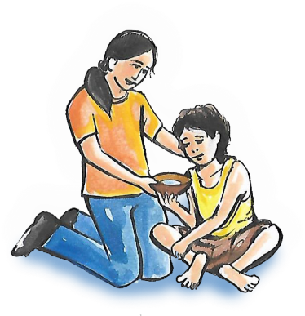
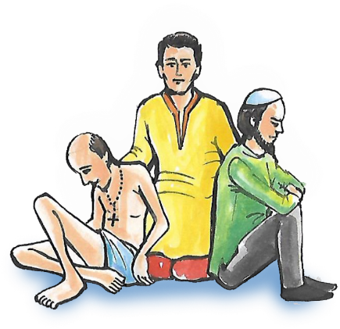
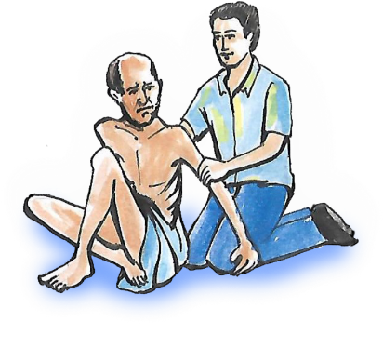
LOGO
1. The luminous circle represents the Radiance of God the Father, which enlightens every human person to love and serve humanity.
3. The dove symbolises the Holy Spirit, God the Holy Spirit, who strengthens us with His gifts and fruits to carry on His mission.
2. The extended hand is of Jesus, God the Son, who invites us to reach out and share our resources with the poor and the needy.
5. Dark silhouettes: We choose to empathize and reach out to the needy, the wounded, the marginalized and the disadvantaged, irrespective of class, creed, caste or race.
4. Rays: We, Christ's faithful, are sent out to live His mandate, "Go and do likewise."

Slide 8
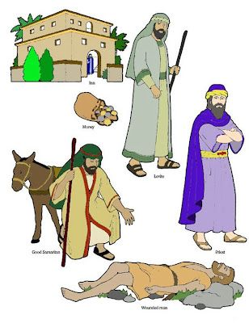
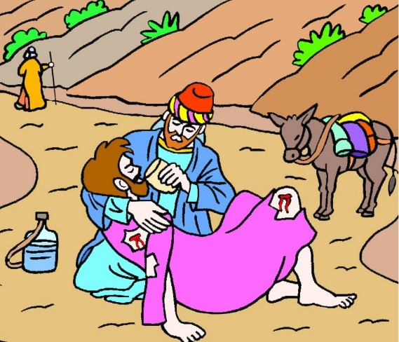
THE PARABLE OF THE GOOD
SAMARITAN
A WARNING
To accept the identity of the other
To take Responsibility for our neighbour
To trust in God more than on our
own strength
To take the Risk of Doing Good
AN INSPIRATION
To uphold Human Dignity
To witness through Compassion
To heal the Wounded
To be generous in Almsgiving

Slide 9
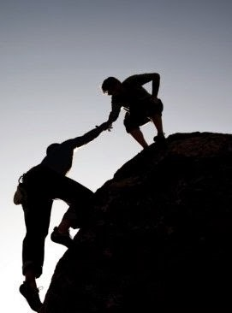
1.1. AN INSPIRATION: To uphold Human Dignity
A person has
TWO hands,
One for helping HIMSELF,
The other for helping
OTHERS

Slide 10
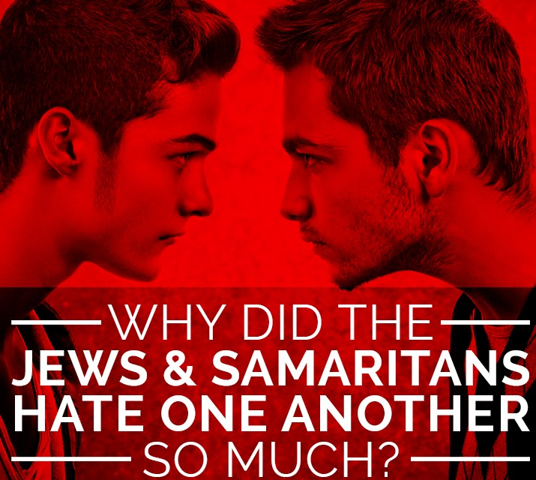
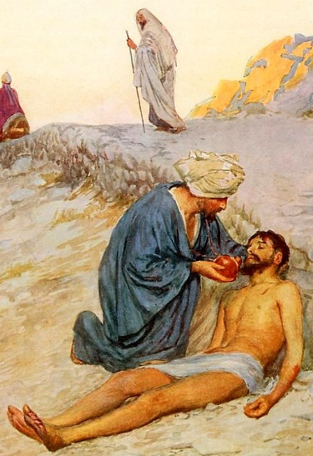
The Samaritans and Jews could not get along with each other.
Jews loathed Samaritans, ostracized them and treated them like dirt.
A wall of social discrimination had risen between them.
Samaritan woman for water to drink, she protests, “How can you, a Jew, ask me, a Samaritan woman, for a drink?” (Jn 4: 9).
The Samaritan in our parable cares little about this discrimination and upholds human dignity: he does not hesitate to give new life to the injured and half-dead Jew.

Slide 11
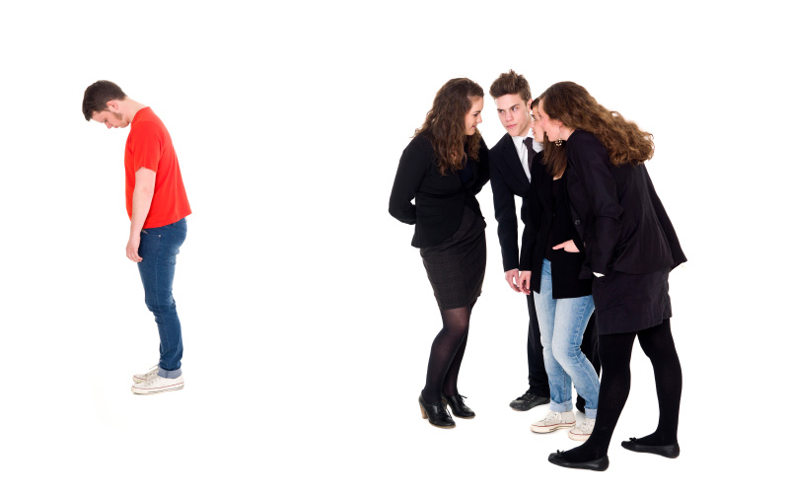
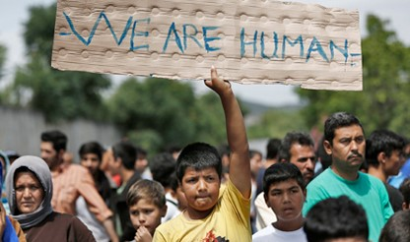
We observe many discriminations in today's society on the basis of caste, creed, political affiliation, etc.
Particularly affected are the migrants, who have to face severe challenges and hardships at various levels.
In the face of these differences, let us take inspiration from the Good Samaritan and 'go and do likewise.'

Slide 12
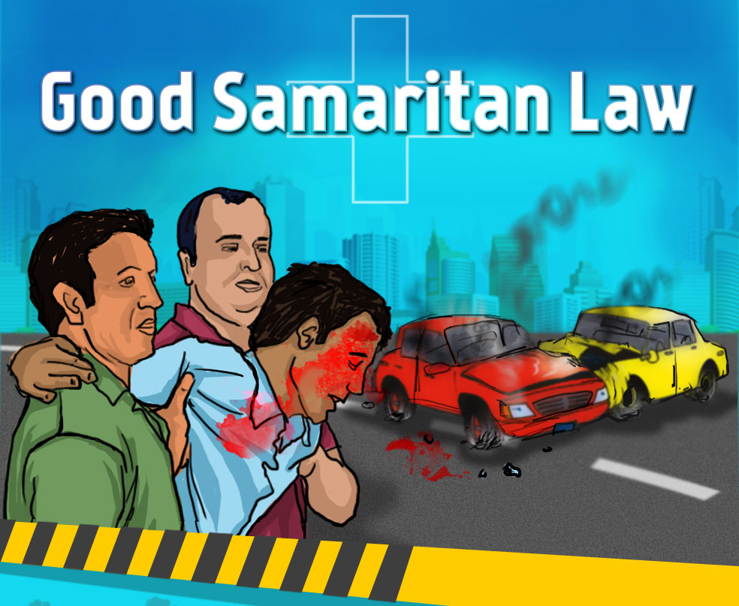
1.2. AN INSPIRATION
To witness through Compassion

Slide 13
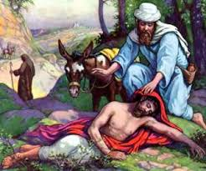
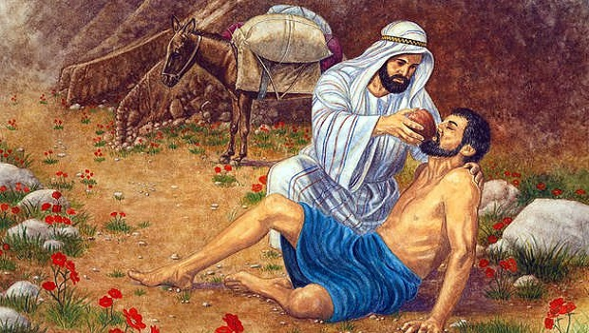
compassion for the Jew - a good deed for the one in need
Compassion: to do a good deed for the one who is in need, placing the good of others above our own and keeping our comforts aside.

Slide 14
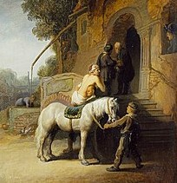
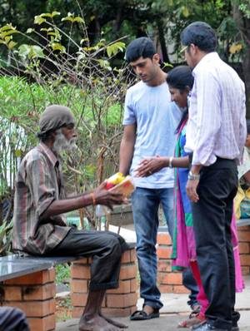
Keep aside our selfishness and uphold the wellbeing of others.
Love should not be just words and talk, but in action (St. John 3: 18)
Faith without good works is dead (St. James 2: 26b)
G. S. Manifests goodness, keep aside selfishness

Slide 15
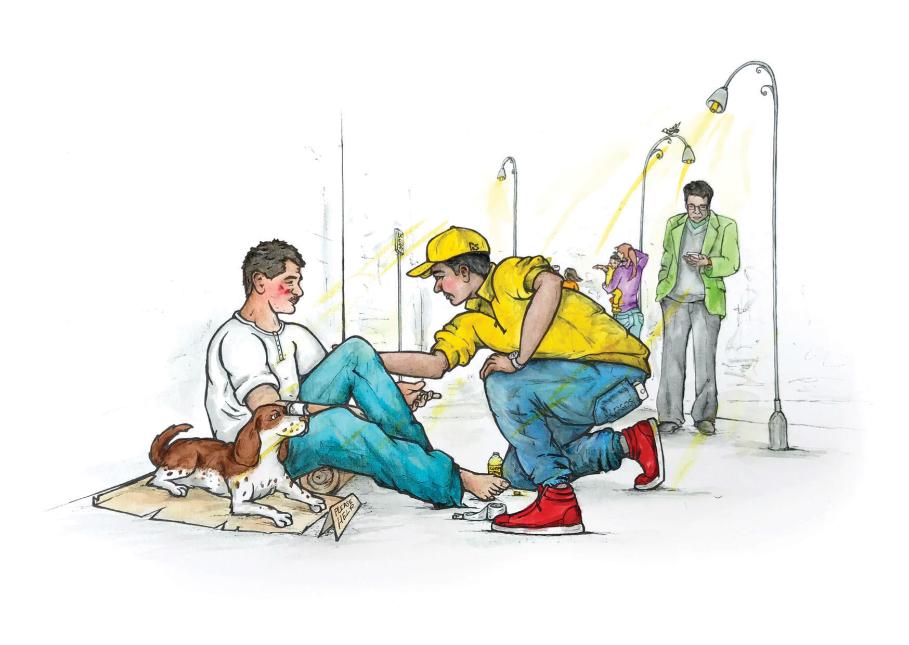
1.3. AN INSPIRATION: To heal the wounded

Slide 16
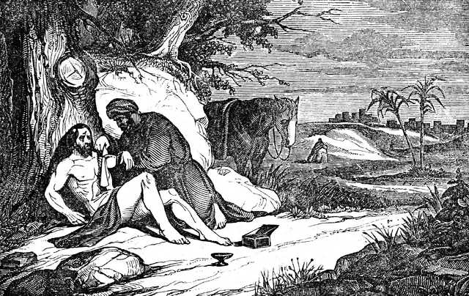
the Good Samaritan tends to the wounded man, pouring oil and wine over his wounds and bandaging them. Oil and wine are symbols of healing.

Slide 17
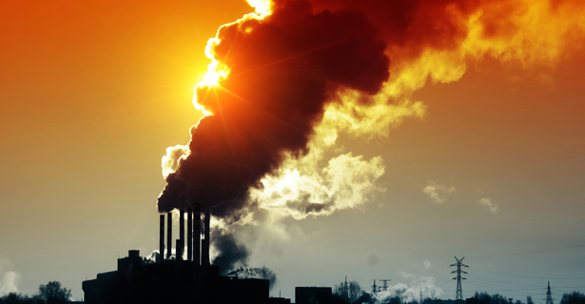
Various physical illnesses are on the increase, most prominent among which is cancer
there are diverse ills and various types of wounds
Counselling and hope
(human accompaniment)
we need to feel co-responsible and be active collaborators in this work.

Slide 18
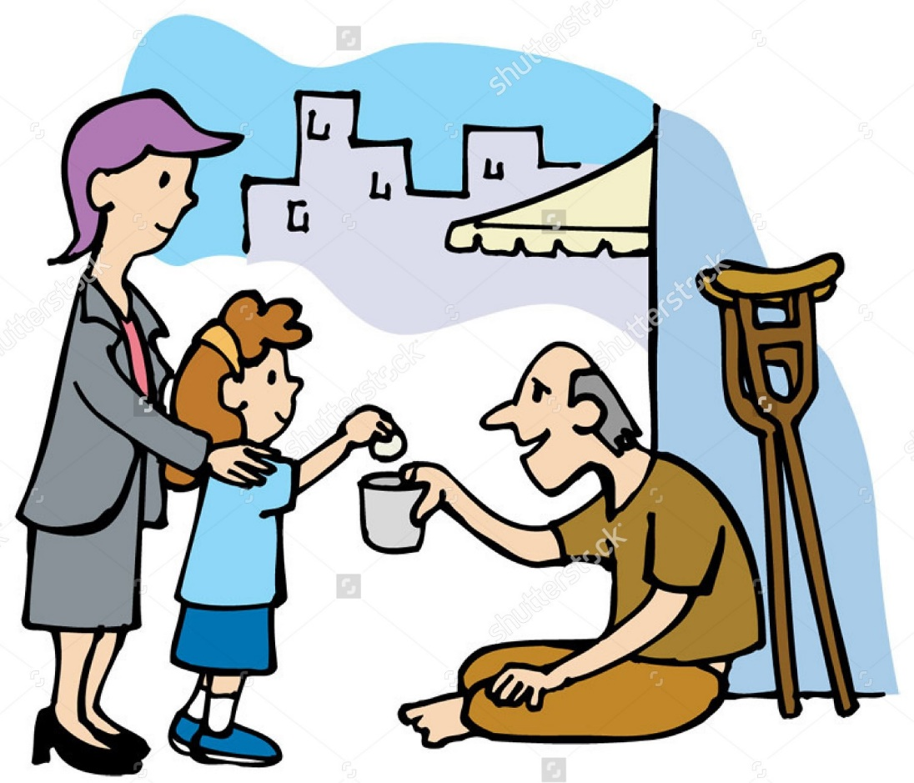
1.4. An Inspiration To be generous in Almsgiving

Slide 19
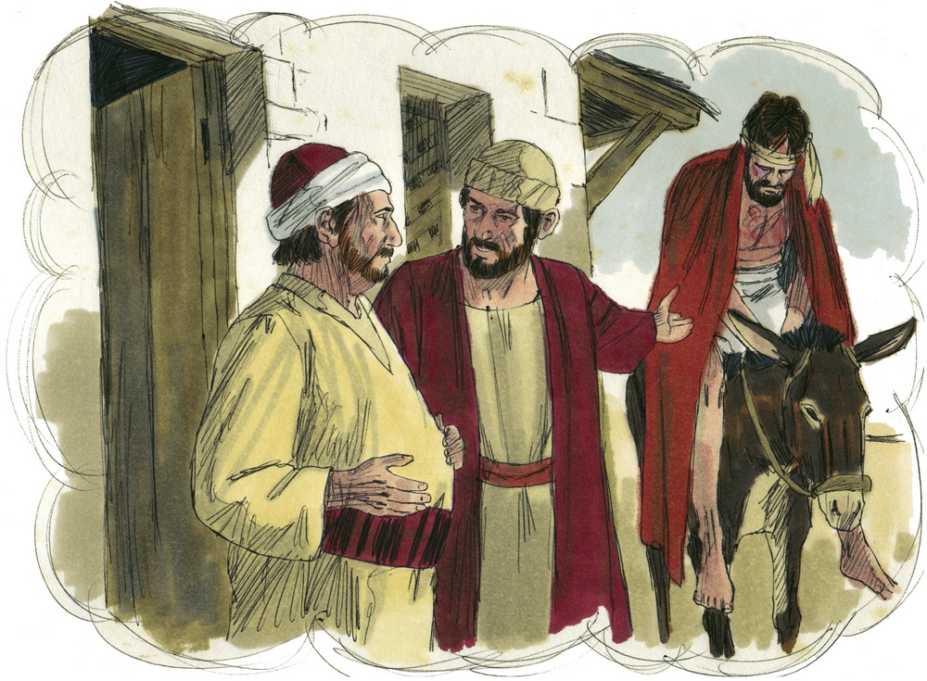
shows desire and good will to give even more: “When I come back, I will pay you whatever else you have spent on him” (Lk 10: 35).
the Good Samaritan uses his own money and donkey to usher the injured Jew to a safe place.
Contributes two denarii - were enough to pay for a person's lodging for twenty four days

Slide 20
An Initiative of the Archdiocese
Goans – known; contribute, appreciate our faithful
Benefit – those in various types of difficulties or wounded in various ways
establish it at the parish level without delay

Slide 21
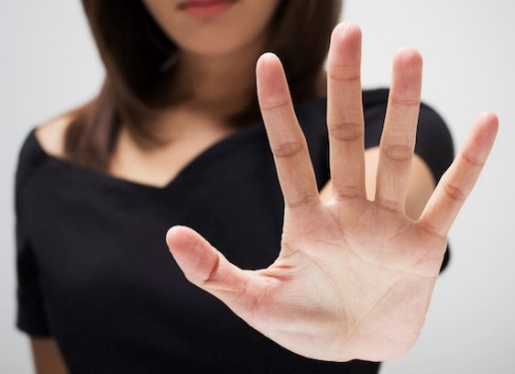
PARABLE OF THE GOOD SAMARITAN IS A WARNING

Slide 22
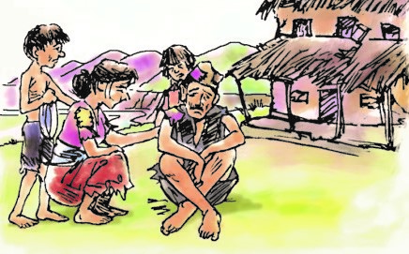
2.1. A Warning: To Accept the Identity of the Other

Slide 23
among the three acted as a neighbour - “the one who showed him compassion”
scribe, while answering, refuses to recognize the identity of the one who showed compassion;
he does not even mention the word 'Samaritan.'
Recognize the identity of the one who showed compassion

Slide 24
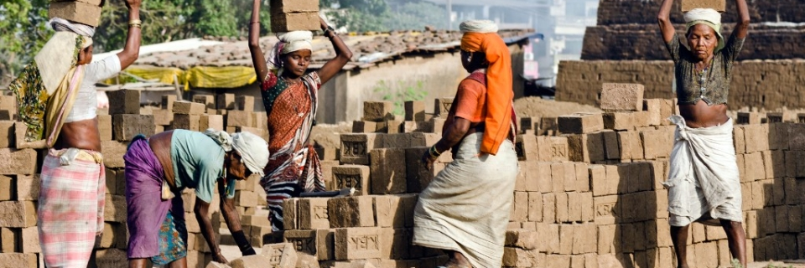
Do not refuse
to acknowledge
the identity of people:
Friend’s circle, migrants…
The parable is thus a warning for us to avoid such temptations.

Slide 25
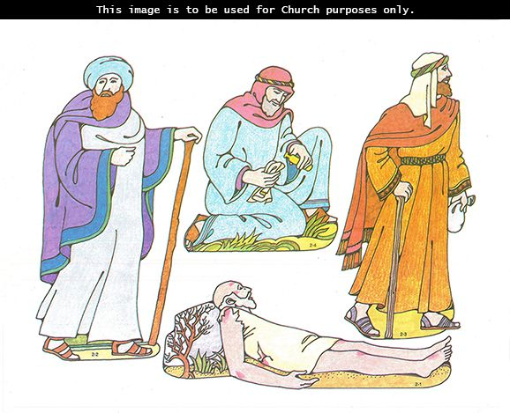
2.2. Warning: To take Responsibility for our Neighbour
the Jewish priest and the Levite see the pitiable state of the unfortunate Jew, but pass by on the opposite side

Slide 26
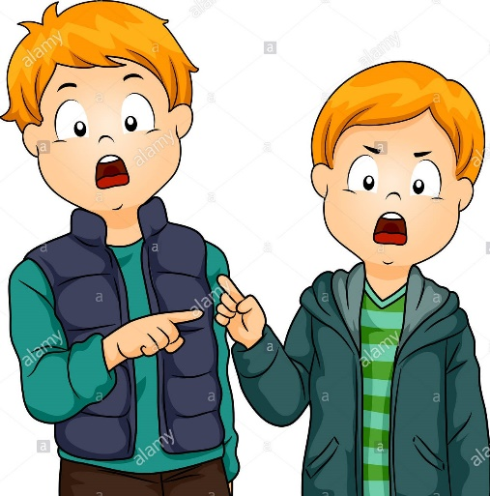
It’s the duty of
Priests, Nuns, Parish Council Members, Political and Social Leaders – thinking is on increase…
The parable is thus a warning for us to avoid such temptations.

Slide 27
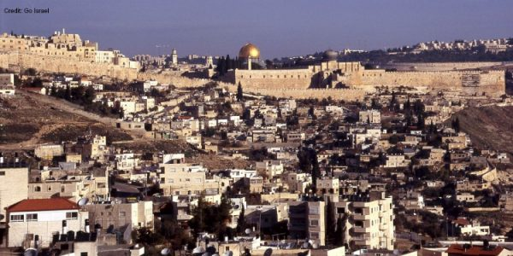
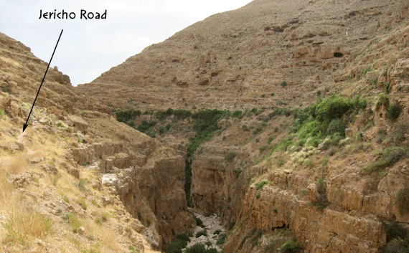
2.3. Warning: To trust in God more than on our own strength
J e r u s a l e m
Red Way
Grace and God’s presence
Prosperous, Date palms, trees blossomed; lots of money, looting…
the injured man was going from Jerusalem to Jericho.
That road was not safe in those days;
it was even called the 'Red Way,'
because it was witness to a lot of bloodshed and even murders.

Slide 28
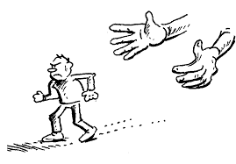
When we go away from God, entrapped by the pleasures of the world we’re likely to face trouble…
The parable is thus a warning for us to avoid
temptations of keeping God aside

Slide 29
2.4. Warning: To take the Risk of Doing Good

Slide 30
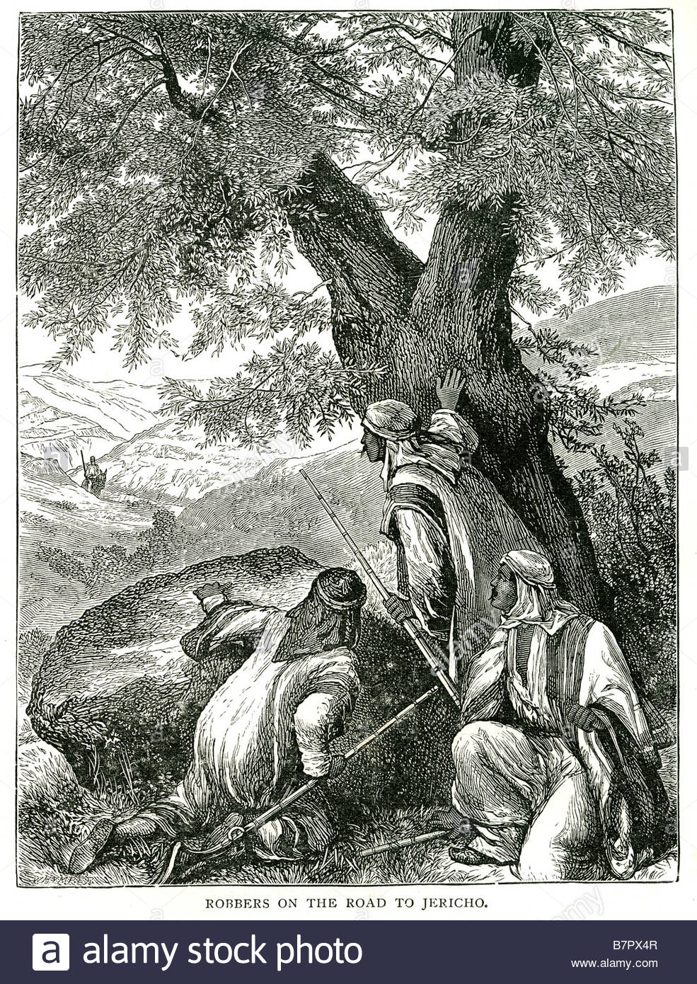
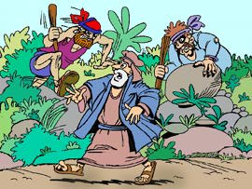
From Jerusalem to Jericho, robbers would often pretend that they were injured or dead and when someone approached to help them, they would pounce on the unsuspecting person and rob him.

Slide 31
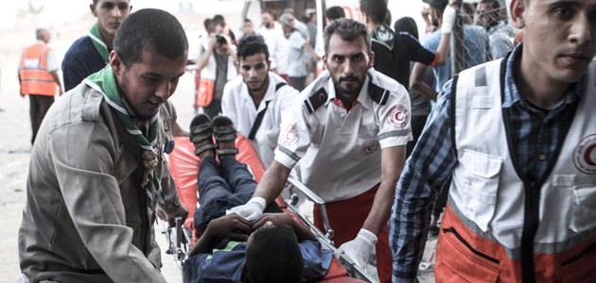
As followers of Christ, we are often afraid of taking risks to practice the good.
'My reputation will be at stake'
'I may have to suffer’
'good is repaid by evil’
– such thoughts may keep us away from doing good.
The parable is thus a warning for us to avoid such temptations.

Slide 32
I N S P I R A T I O N

Slide 33
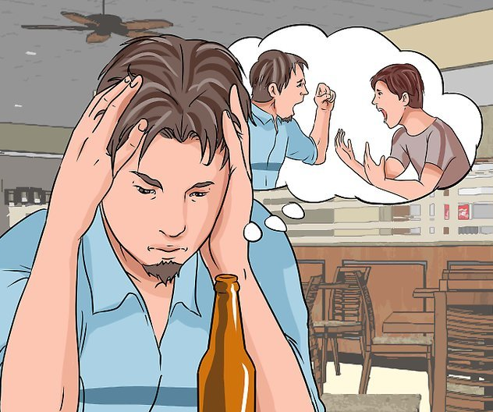
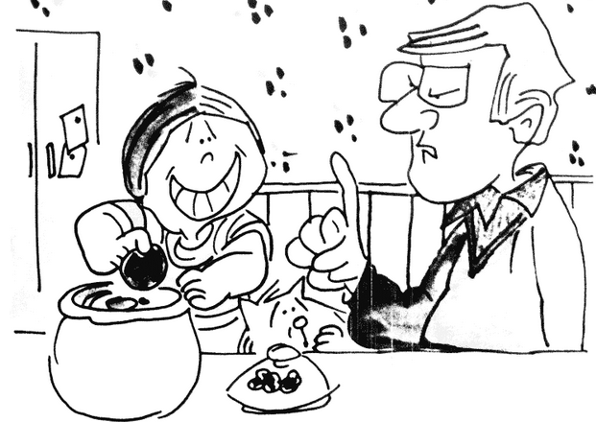
Good Samaritan warns us... to avoid temptation to...
Give less respect to others
Pretend that we do not know them
Give up our responsibility towards our neighbour
Dump it on others
Be entrapped by the lures of the world
Live without God
Avoid the opportunity of taking risks to do good

Slide 34
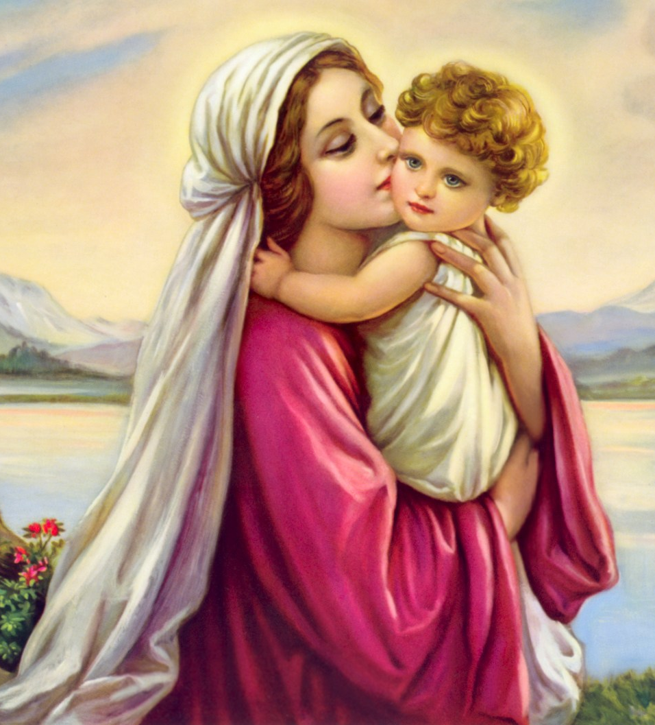
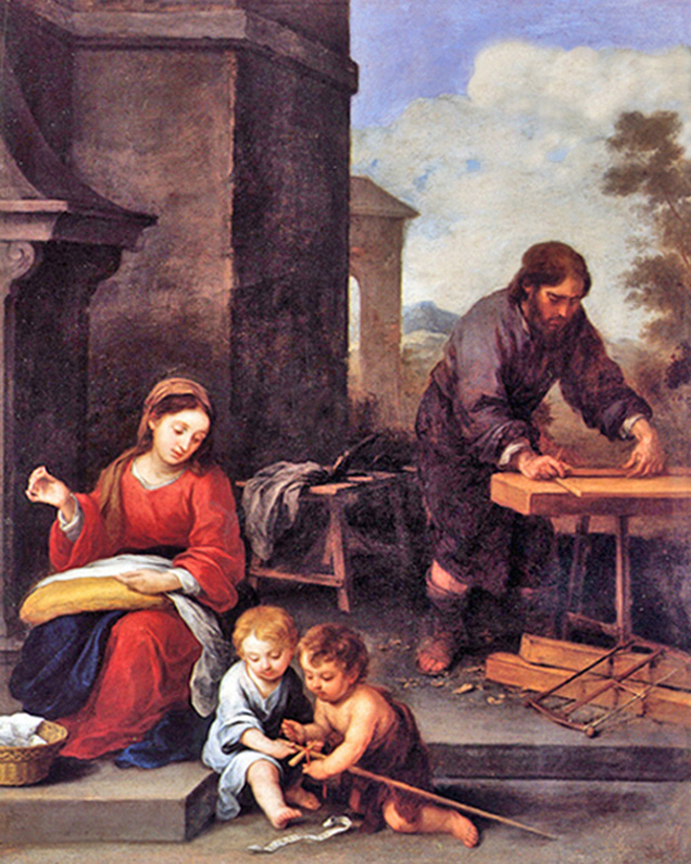
Blessed Virgin Mary, our Heavenly Mother lived for God and for others

Slide 35
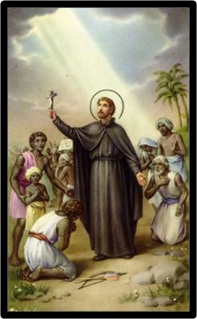
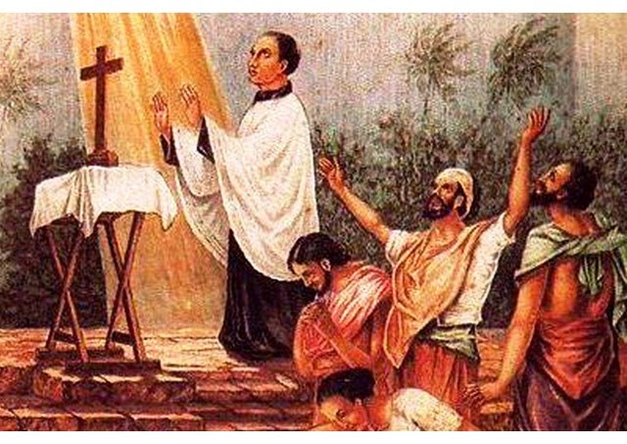
St. Francis Xavier... Patron of Goa
St. Joseph Vaz... Patron of our Archdiocese
Inspired by the two Saints....
let us strive to be courageous instruments of God's
caring love in our times

Slide 36
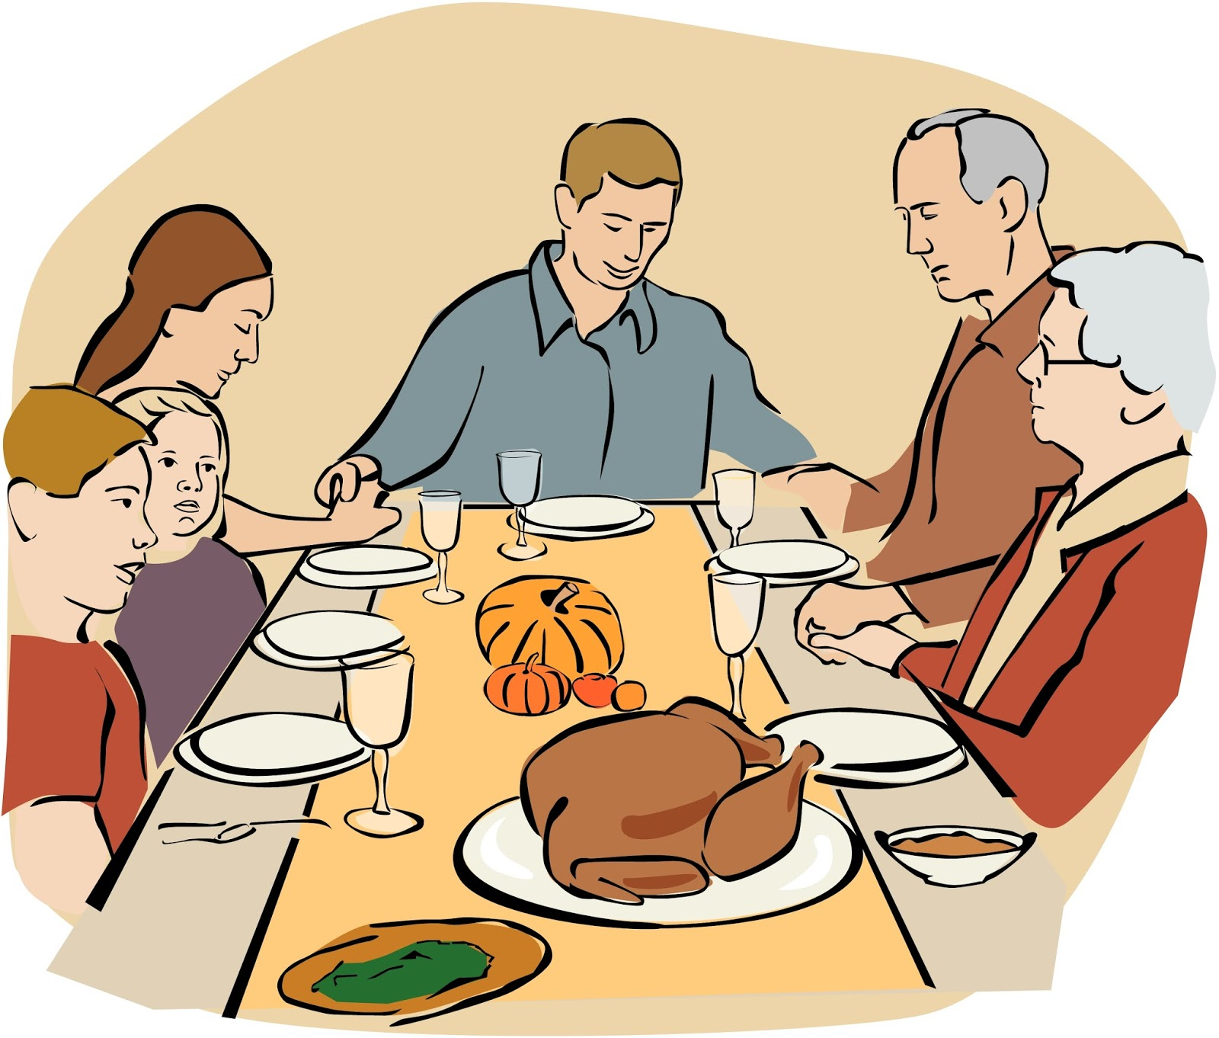
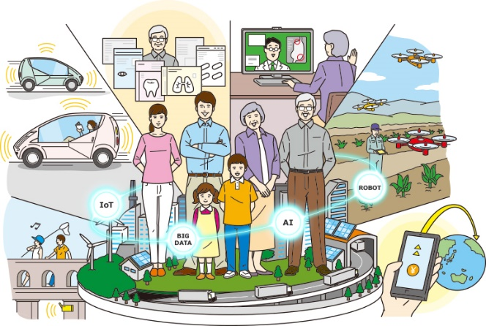
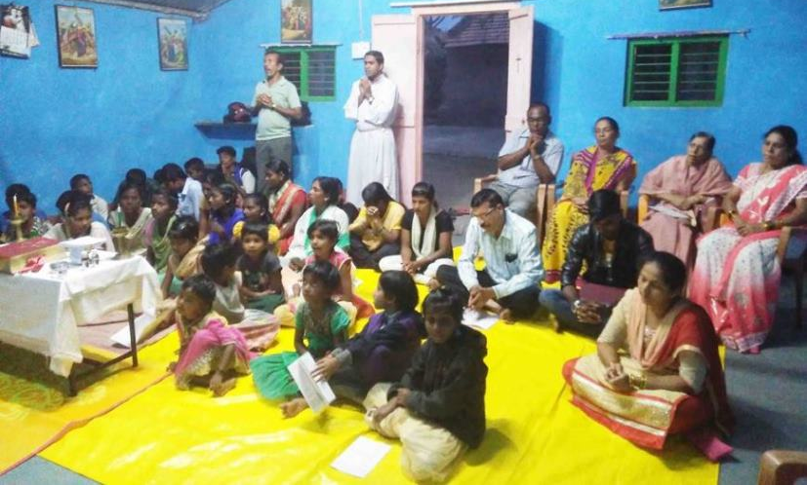
1. KUTTUMBANT
A C T I O N
P L A N
2. SOMUDAYANT
4. SOMAZANT
3. FIRGOJENT

Slide 37
Mon’xachem vorteponn
samballum-ia:
Sogllea lokam sovem ontor korinastanam tanchem khaxelponn rakhum-ia:
Cheddo-cheddum,
differently abled,
pidda sonstoleank,
zantteam sovem…
Migrants, dublle, onollkhi,
gorjek sampoddlolea sovem usko dakhoum-ia...

Slide 38
Ghayall zal’leank
pekovnni dium-ia:
Amchea danam ani gunnam vorvim udarponn dakhoum-ia:
Amche girestkayecho kaim faido gorjevontank vanttum-ia,
Gorib bhurgeancheo school fees farik korum-ia,
Goribank ghor bandunk adar korum-ia...
Eksureank amcho vell dium-ia,
antrunar asloleanchi mogan seva korum-ia, tanchi niga gheum-ia…

Slide 39
Oddchoneank sampoddloleanche
churchure korum-ia:
Vegllocharachim
durgam
moddum-ia:
Bhett diun,
magnnem korun,
khannacheo vostu vanttun,
okdam diun...
Xetam-bhattank lagon dusmankai sompoum-ia,
tunttlole sombondh ghott korum-ia,
ganvant Saibinnichi bhett kuttumbant zata tednam ami vantto gheum-ia...

Slide 40
4. SOMAZANT
Mon’xachi goroz vollkhun tanche sovem zababdari pallum-ia:
Doyallayentlean
sakxi dium-ia:
Hospitalant niamit piddevontank bhett dium-ia
Akantak sampoddloleam sangata magnnem korum-ia
Goribam sangata jevonn korum-ia...
Niti pasot vaurum-ia,
Sot uklun dhorum-ia,
Poriavoronn ani xristi samballum-ia,
Somajik prosnamni ani Gram Sabhache zomatimni vantto gheum-ia...

Slide 41
DIOCESAN CATECHETICAL CENTRE PASTORAL INSTITUTE ST. PIUS X, OLD GOA
DEV BOREM KORUM

